Slide 1
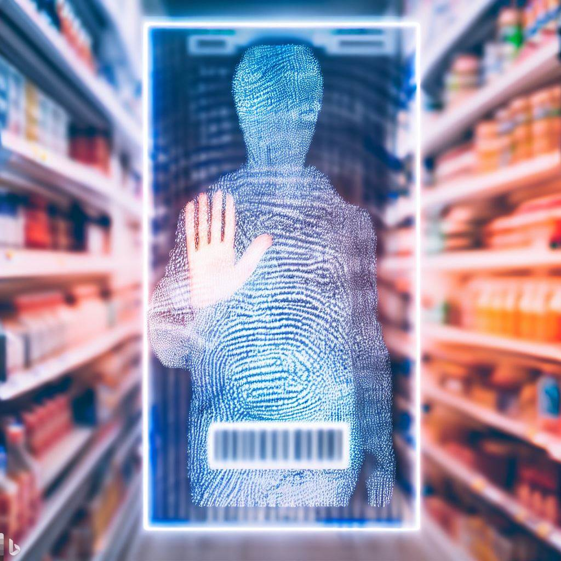
BIOMETRICS IMPACT: PRIVACY & PUBLIC PERCEPTION IN SUPERMARKET SHOPPING.
Bridging Technology and Consumer Trust
Presented by TAMIM HASAN
https://www.bing.com/images/create
Student ID: 30 43 25 76
Notes:
Good afternoon/evening, everyone.
My name is Tamim Hasan, and today I am going to give a presentation on my research proposal on
"BIOMETRICS IMPACT: PRIVACY AND PUBLIC PERCEPTION IN SUPERMARKET SHOPPING."
https://www.bing.com/images/create
TAMIM HASAN
Date 07/09/2023

Slide 2
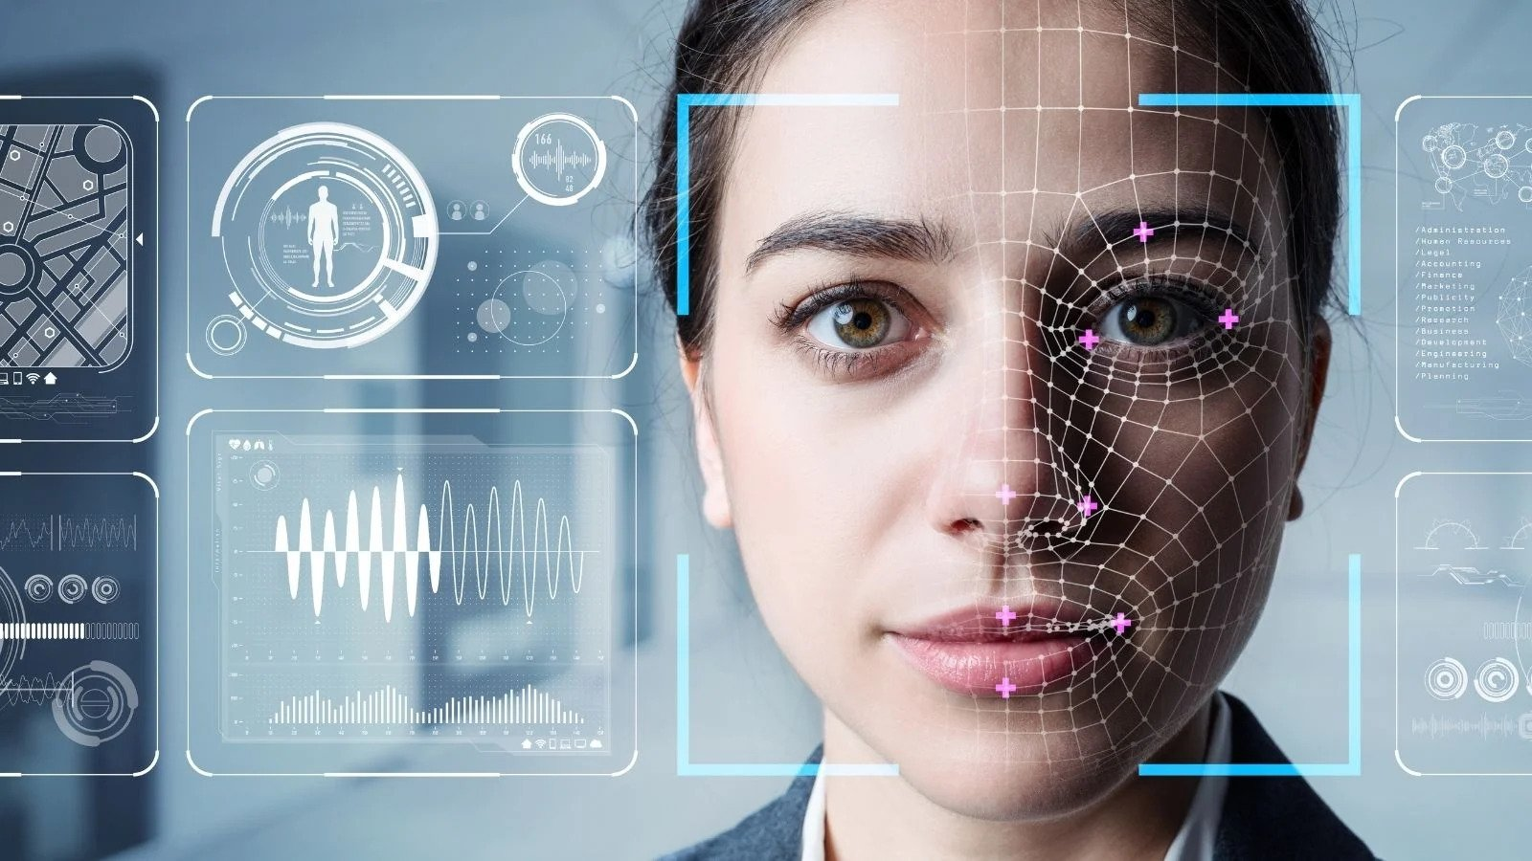
The Prevalence Of Biometric Technology
Biometrics at the Airport: Why the Travelsphere’s Future is Digital. (2022). https://www.oag.com/hubfs/Blog_Post_Images/2022/Travel_Tech_Biometrics_Mar/Biometrics-Airport.jpg
Notes:
Think about our world today – it's all about fancy technology, right? We use our fingerprints to unlock our phones, and we've got cameras that can recognize our faces to make things more secure. These are all thanks to something called "biometric technology." It's become a big part of our lives.
But today, I want to talk about something important. I want to take you on a journey to understand how this technology affects our privacy. And even more interestingly, I want to explore how regular folks like us really feel about it, especially when we're just doing our regular supermarket shopping.
So, let's dive in and figure out what's going on with this tech and our privacy in everyday life.

Slide 3

Explore the impact of biometric technology in supermarkets.
Investigate privacy concerns and public perception.
Provide insights for stakeholders.
Purpose of the Study
Walmart Partners with Suppliers to Reduce Prices. (2023). https://www.ilevellogistics.com/featured-aggregation/walmart-partners-with-suppliers-to-reduce-prices
Notes:
Purpose of the Study
But first, let us ponder the purpose of our endeavor.
We seek to understand how biometric technology is changing the way we shop. How does it affect your experience in the supermarket aisle?
Our objectives are clear:
To explore the impact of biometric technology in supermarkets.
To investigate the privacy concerns it may raise.
And most importantly, to provide valuable insights for those who shape the future of retail.

Slide 4

Research Gap
Lack of insight into biometrics in supermarkets.
Meden et al. (2021) and Pizzi et al. (2022) highlight privacy concerns.
Slack, Singh, and Sharma (2020) and Rahman et al. (2022) emphasize consumer attitudes.
De Keyser et al. (2021) suggest understanding factors affecting biometric adoption.
Tilemap and small gap (SOLVED). (2018). https://forum.defold.com/t/tilemap-and-small-gap-solved/19317
Notes:
As we set sail on this exploration, we must recognize the gap in our understanding of biometrics in supermarkets.
While biometrics are increasingly common in our daily lives, there's surprisingly little research on how consumers perceive them in the context of grocery shopping.
References like Meden et al. (2021) and Pizzi et al. (2022) have hinted at the need to address privacy concerns.
Slack, Singh, and Sharma (2020) and Rahman et al. (2022) underscore the importance of understanding consumer attitudes.
De Keyser et al. (2021) suggest the need to explore factors influencing biometric adoption.
References:
De Keyser, A., et al. (2021). "Opportunities and challenges of using biometrics for business: Developing a research agenda." Journal of Business Research 136: 52-62.
Meden, B., et al. (2021). "Privacy–enhancing face biometrics: A comprehensive survey." IEEE Transactions on Information Forensics and Security 16: 4147-4183.
Pizzi, G., et al. (2022). "Privacy concerns and justice perceptions with the disclosure of biometric versus behavioral data for personalized pricing tell me who you are, I’ll tell you how much you pay. Consumers’ fairness and privacy perceptions with personalized pricing." Journal of Business Research 148: 420-432.
Rahman, M., et al. (2022). "An empirical analysis of cashless payment systems for business transactions." Journal of Open Innovation: Technology, Market, and Complexity 8(4): 213.
Slack, N., G. Singh and S. Sharma (2020). "The effect of supermarket service quality dimensions and customer satisfaction on customer loyalty and disloyalty dimensions." International Journal of Quality and Service Sciences 12(3): 297-318.

Slide 5

Research Questions & Aim
Research Questions
How do consumers perceive biometric technology in supermarkets?
What are the specific privacy concerns associated with supermarket biometrics?
What strategies can enhance public acceptance of biometrics in supermarkets?
Aim
To understand the relationship between biometric technology, privacy concerns, and public perception in the context of supermarket shopping.
Robinson, B. A. (2017). Things to Do With Magnifying Glasses. https://sciencing.com/things-do-magnifying-glasses-5503487.html
Target Dart Aim Free Photo. https://www.needpix.com/photo/640388/target-dart-aim-objective-success-goal-game-dartboard-perfect#google_vignette
Notes:
To bridge this gap, we've crafted a set of essential research questions:
Our key inquiries include:
How do consumers perceive biometric technology in supermarkets?
What specific privacy concerns are associated with supermarket biometrics?
What strategies can enhance public acceptance of biometrics in supermarkets?
Our main aim is clear:
We strive to understand the intricate relationship between biometric technology, privacy concerns, and public perception within the realm of supermarket shopping.

Slide 6

—Hypotheses
Privacy concerns vary across demographic groups.
Convenience significantly impacts acceptance vs. privacy concerns.
Data Science Degree vs. Statistics Degree: Analyzing the Difference. https://online.maryville.edu/blog/data-science-degree-vs-statistics-degree/
Notes:
To fulfill this aim, we have two guiding hypotheses:
Hypothesis 1: Privacy concerns associated with biometric technology in supermarkets vary across demographic groups.
Hypothesis 2: The level of convenience provided by biometric technology in supermarkets significantly impacts consumers' acceptance compared to their privacy concerns.
(This hypothesis suggests that individuals from different demographic backgrounds, such as age, gender, income, or education level, may have varying levels of privacy concerns when it comes to using biometric technology in supermarkets. The hypothesis implies that factors related to personal demographics might influence how people perceive and prioritize their privacy when interacting with biometrics in a supermarket setting.
For instance, younger individuals might be more accustomed to technology and, therefore, less concerned about privacy, while older individuals may have higher privacy concerns due to less familiarity with biometrics. Gender, income, and education levels could also impact how people view the privacy implications of using biometrics in supermarkets.)
(This hypothesis posits that the extent to which consumers value the convenience offered by biometric technology in supermarkets plays a crucial role in determining their acceptance of these systems. It suggests that if the convenience factor is perceived as high and outweighs privacy concerns, individuals are more likely to accept and use biometrics in supermarket shopping.
Conversely, if privacy concerns outweigh the perceived convenience, consumers may be less inclined to embrace biometric technology in this context. This hypothesis recognizes that convenience and privacy are two competing factors, and their relative importance influences consumer acceptance.)

Slide 7
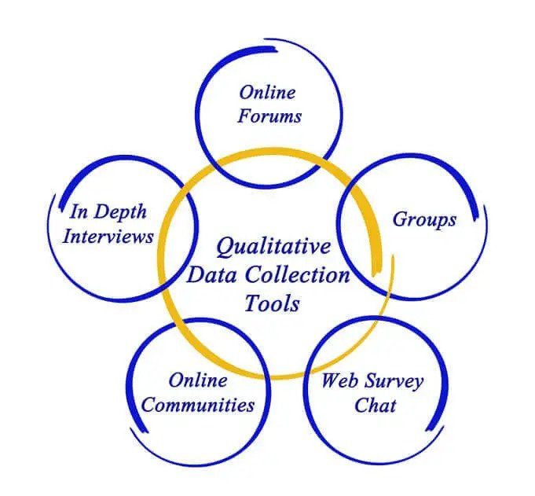
Methodology & Data Collection
"How can quantitative research complement and enhance qualitative research?"
Mixed Methods Approach
Quantitative
Qualitative
Surveys
Interviews
Longe, B. 7 Data Collection Methods & Tools For Research. https://www.formpl.us/blog/data-collection-method
Notes:
Now, let's talk about how we plan to unearth these answers.
Our chosen path is a mixed methods approach. We'll use both quantitative research through surveys and qualitative research via interviews.
Quantitative research helps us identify trends, while qualitative research provides context and the "why" behind these trends.
There could be a question:
How can quantitative research complement and enhance qualitative research?
Answer would be:
Validation of Qualitative Findings: Quantitative data can help validate qualitative findings(Bryman, 2006; Yu, 2009). For example, if qualitative interviews reveal privacy concerns among consumers, quantitative surveys can confirm the prevalence and extent of these concerns within a larger population.
Identifying Trends and Patterns: Quantitative analysis can identify trends and patterns within the data(Bryman, 2016; Morse, 1991). For instance, it can reveal demographic factors (such as age, gender, or income) that significantly influence privacy concerns, adding nuance to qualitative findings.
Statistical Significance: Quantitative research can assess the statistical significance of relationships or differences, confirming whether observed trends are substantial or due to chance(Onwuegbuzie & Johnson, 2006). This statistical rigor enhances the credibility of research outcomes.
Comparative Analysis: Quantitative data can facilitate comparative analysis(Flick, 2018). We can compare the acceptance of biometric technology in supermarkets with its acceptance.
Thank you for joining me on this quest.
References:
Bryman, A. (2006). Integrating quantitative and qualitative research: how is it done? Qualitative research, 6(1), 97-113.
Bryman, A. (2016). Social research methods. Oxford university press.
Flick, U. (2018). Designing qualitative research. Designing Qualitative Research, 1-200.
Morse, J. M. (1991). Approaches to qualitative-quantitative methodological triangulation. Nursing research, 40(2), 120-123.
Onwuegbuzie, A. J., & Johnson, R. B. (2006). The validity issue in mixed research. Research in the Schools, 13(1), 48-63.
Yu, C. H. (2009). Book review: Creswell, J., & Plano Clark, V.(2007). Designing and conducting mixed methods research. Thousand oaks, CA: sage. Organizational Research Methods, 12(4), 801-804.

Slide 8
Q&A

